Slide 1
Shell Bootcamp 2024 3 Reflections for Week 2
Akshay Rai
Date : 6-Sept-2024

Slide 2

About Me
Patience is not the ability to wait but the ability to keep a good attitude while waiting

Slide 3

My learnings from this week!

Slide 4
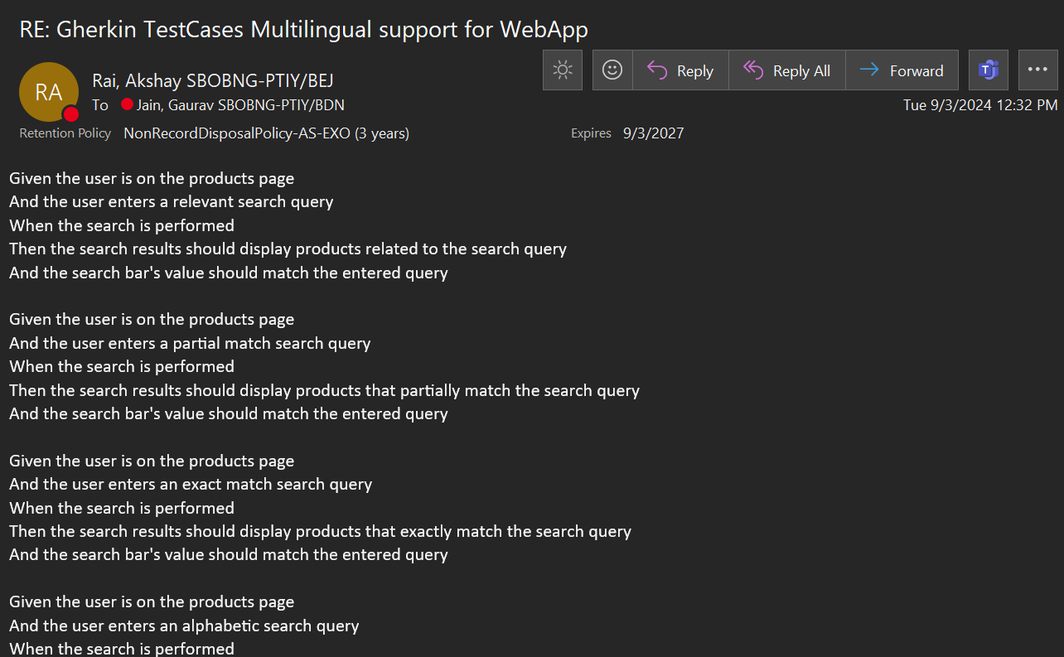
Learning 1 | My takeaways
Key Learning: Understanding the sequence of activities in STLC, from requirement analysis to test cycle closure.
Key Takeaway: Efficient testing ensures software reliability and quality, saving time and resources.
Implementation in Energy Sector: Ensures robust software for energy management systems.

Slide 5
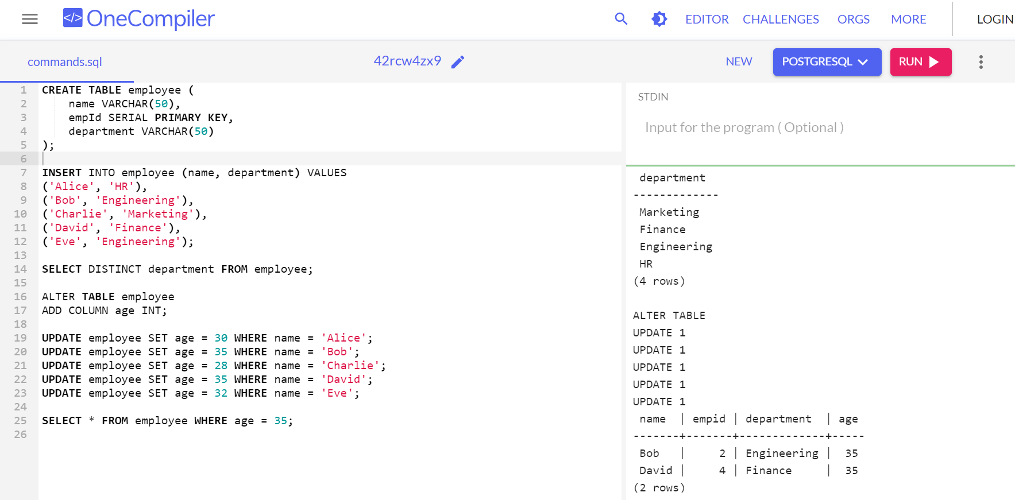
Learning 2 | My takeaways
Key Learning: Setting up workflows for continuous integration and continuous deployment using GitHub Actions and learning use cases of PostgreSQL .
Key Takeaway: Automating code integration and deployment enhances development speed and reduces errors.
Implementation in Energy Sector: Streamlines updates for energy monitoring applications.

Slide 6
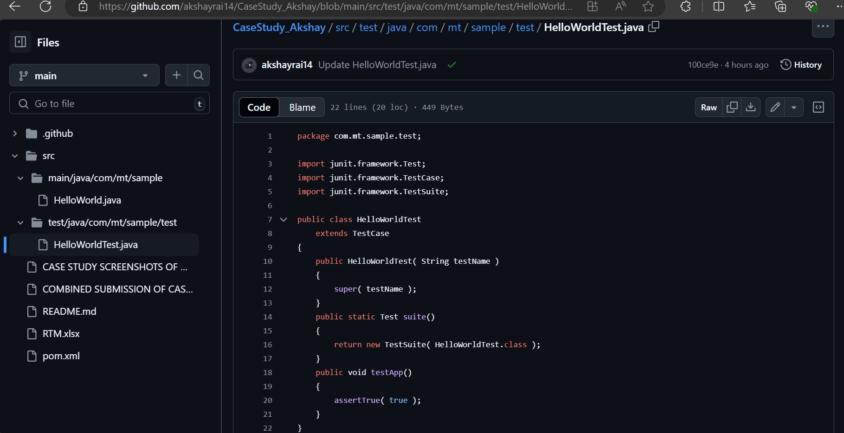
Learning 3 | My takeaways
Key Learning: Working on Case Study where I implement Continuous Integration using Github actions for a java with maven code file and work with Azure VM.
Key Takeaway: YAML file in Github actions has to be configured properly for the CI to work efficiently.
Implementation in Energy Sector: Energy projects where continuous changes are important are implemented in this way.

Slide 7

Relevance of learnings for my organization

Slide 8
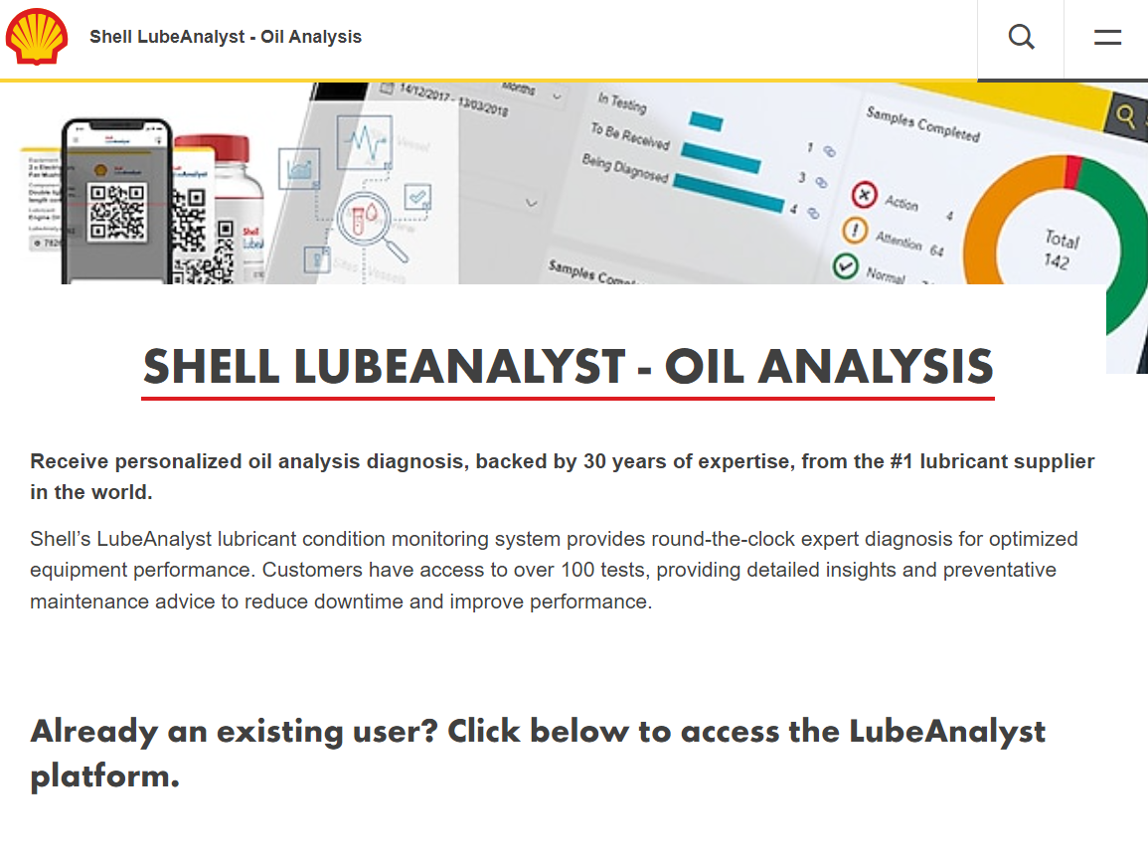
Learning 1 | Relevance for Shell
How I feel Shell implements this learning: Shell meticulously follows the STLC process, from requirement analysis to test cycle closure, to maintain high software quality.
How I feel Shell benefits from this learning: By adhering to STLC, Shell ensures its software is reliable and efficient, reducing downtime and enhancing overall operational efficiency in energy management systems.

Slide 9
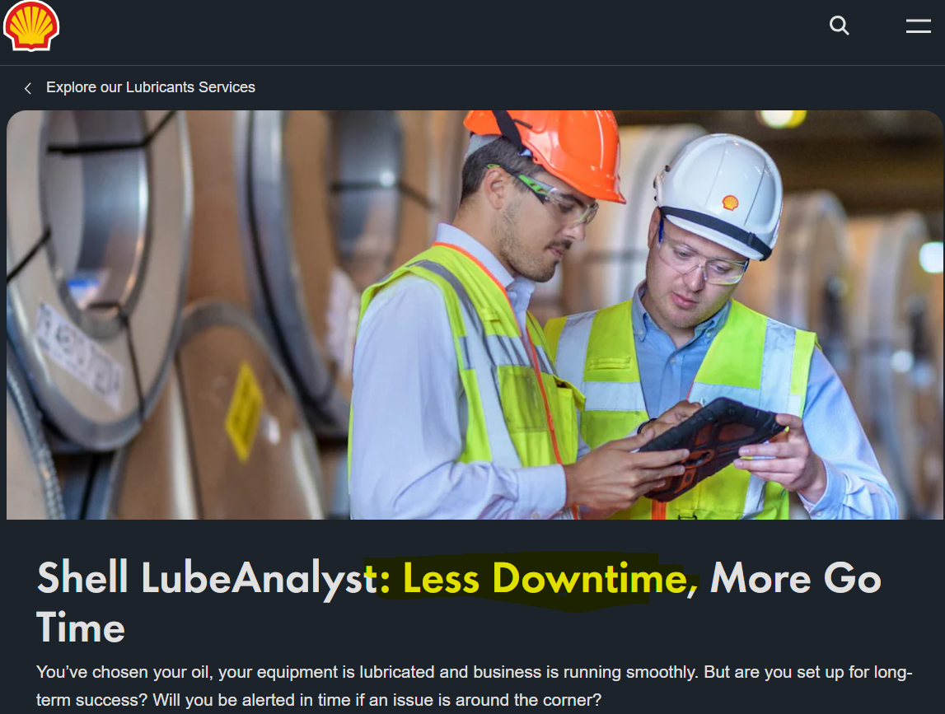
Learning 2 | Relevance for Shell
How I feel Shell implements this learning: Shell uses GitHub Actions to automate code integration and deployment, ensuring that updates are seamlessly integrated without disrupting existing functionalities.
How I feel Shell benefits from this learning: This automation speeds up development cycles and minimizes errors, allowing Shell to quickly adapt to changes and maintain robust energy monitoring applications.

Slide 10
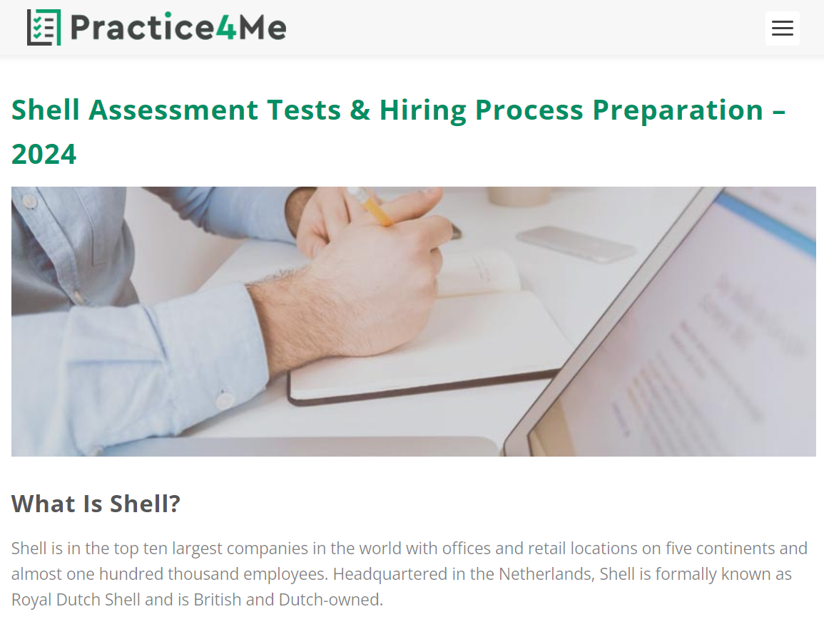
Learning 3 | Relevance for Shell
How I feel Shell implements this learning: Shell configures YAML files in GitHub Actions for efficient CI and uses Azure VMs for testing and deployment, ensuring a seamless workflow from development to production.
How I feel Shell benefits from this learning: Using Azure VMs for testing and deployment ensures that Shell’s energy projects are scalable and reliable, supporting continuous improvements and efficient resource management.
This image
illustrate Shell’s
commitment to
leveraging
advanced
technologies to
optimize their
operations and
ensure safety
and efficiency.

Slide 11

Challenges in implementing learning

Slide 12
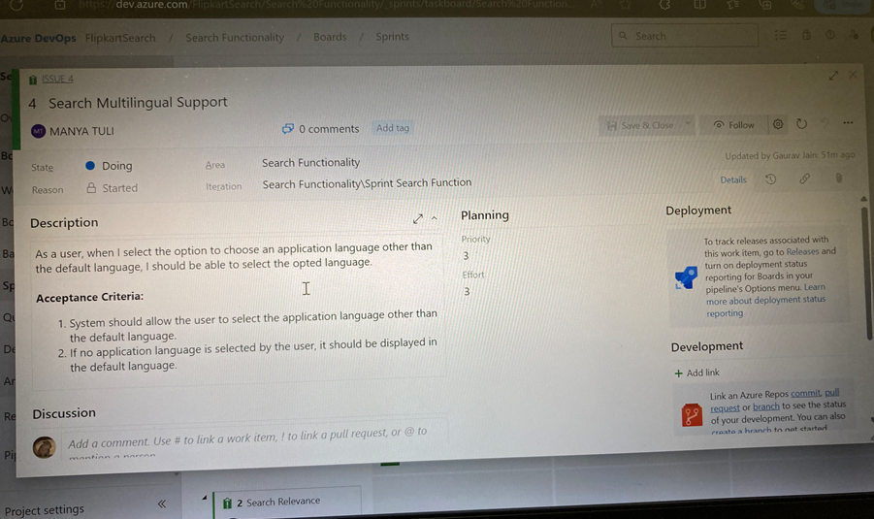
Challenge faced while implementing Learning 1
Challenges I faced: Estimating acceptance criteria and defining story priority on Microsoft Azure Product backlog was difficult. Functional testing helped clarify acceptance criteria.
How I plan to overcome them: Practice estimating criteria and prioritizing stories.

Slide 13
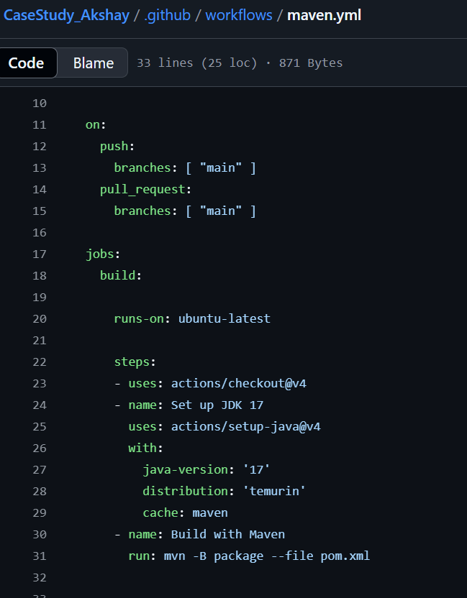
Challenge faced while implementing Learning 2
Challenges I faced: Understanding the YAML file setup for workflows was challenging, causing build failures. Asking the facilitator clarified the workflow.
How I plan to overcome them: Study YAML syntax and workflow examples.

Slide 14
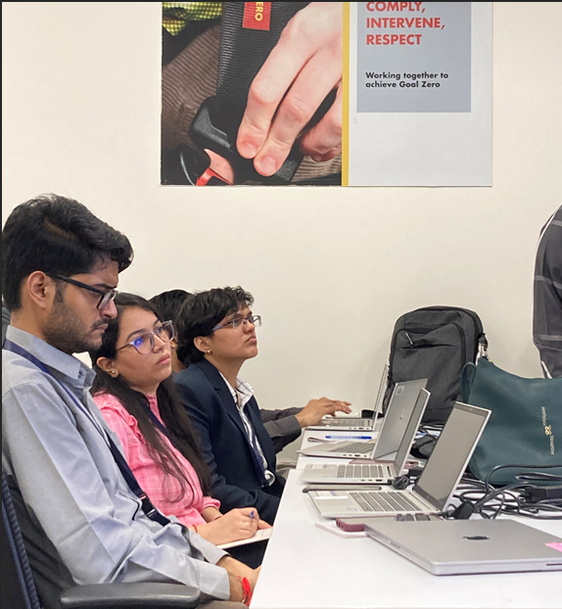
Challenge faced while implementing Learning 3
Challenges I faced: Setting up Azure VM was tedious due to availability zone issues and slow performance. Delegating tasks and adjusting settings resolved the issues.
How I plan to overcome them: Improve VM setup skills and team coordination.
Github Link- akshayrai14/CaseStudy_Akshay: Case Study for workflow and testing (github.com)
A photo of my
team taken
by me when
they were trying
to figure out
the case study
on which we
had to work

Slide 15

Action Plan

Slide 16
My Action Plan for this Week
Actions
Timeline
Status
I plan to enhance my CI/CD pipeline skills by integrating Docker with GitHub Actions. I’ll also write more YAML codes for various small projects to overcome configuration challenges.
I aim to implement these actions within the next two weeks to be well-prepared before joining my team.
By the end of this week, I’ve learned Docker basics, pipelining, PostgreSQL commands, and GitHub Actions. I implemented a case work for a small project in java with Maven where I also worked on Azure VM and Github Actions workflow.

Slide 17

Learning is also Fun!

Slide 18
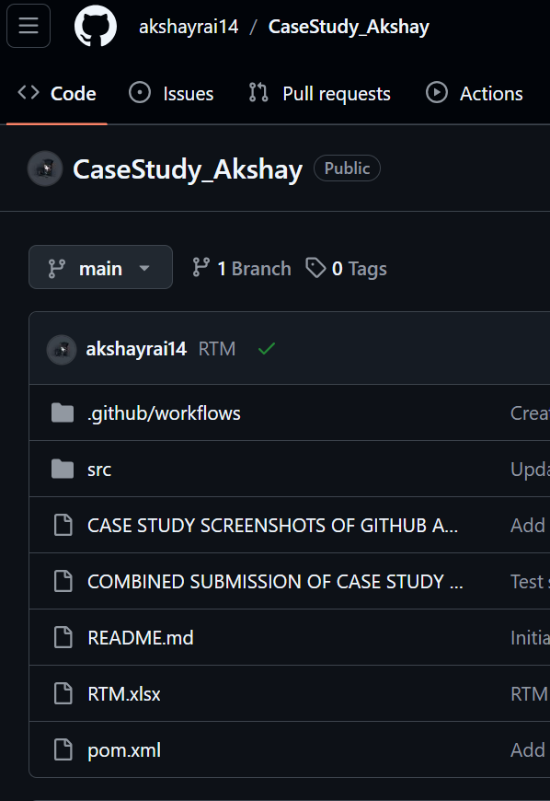
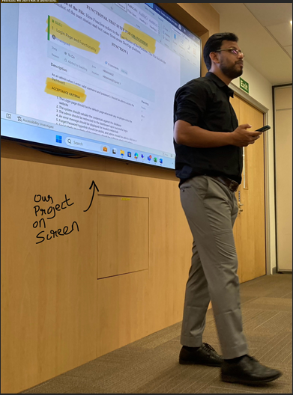
Learning is also Fun!
My learning was fun because our facilitator was energetic and used real-life examples to explain each topic practically. Group work : Setting up the Azure VM was challenging but I successfully deployed the VM in time. I also created the bug report and helped everyone set up the CI workflow using GitHub Actions. Additionally, I compiled the entire documentation, ensuring all details were accurately captured. Funny Incident: I kept confusing YAML and XML files during my presentation, which was quite amusing. When questioned by our facilitator, I finally clarified the concepts in my mind.

Slide 19

Summary
This week focused on the Software Testing Life Cycle (STLC), CI/CD pipelines with GitHub Actions, PostgreSQL, and setting up Azure VMs, culminating in a comprehensive case study.
Upcoming week : Frontend development, .NET code with C#, Application Security, and Experience Design, along with an Openhack event to build an app.
Understanding testing and CI/CD processes will aid in developing secure, efficient frontend and backend applications, ensuring seamless integration and deployment in the upcoming Openhack project.

Slide 20
Thank You

